Slide 1
Put everything together
Based on internet of things from curtin univercity
Steinheim 01.08.2023

Slide 2
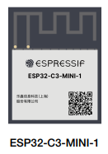

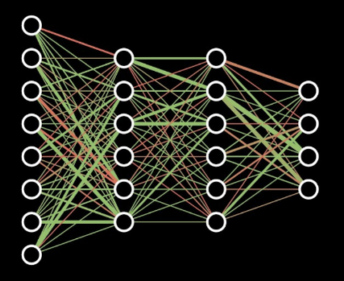
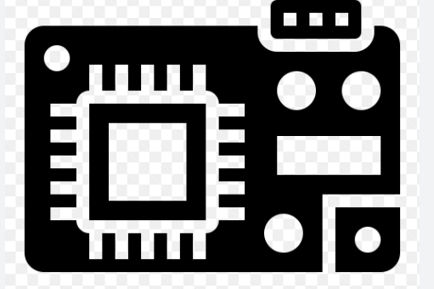

Slide 3
Introduction
General vision of IoT topic in FLEX

Slide 4
Sensor & Basic Components

Slide 5
Voltage sensor
Current sensor
Power switch

Slide 6
Networks & Protocols

Slide 7
From local to cloud : gateway

Slide 8
System Architecture

Slide 9
communication
Short-range technologies such as Bluetooth and ZigBee

Slide 10
System Standardisation

Slide 11
Cloud, Fog and Edge Computing

Slide 12
Gateway

Slide 13
architecture

Slide 15
Edge computing
Fog computing
cloud computing

Slide 17
Device Architecture

Slide 18
hardware platform

Slide 19
memory

Slide 20
sensor

Slide 21
Energy & Battery

Slide 22
Connectivity

Slide 23
Bluetooth

Slide 24
Zigbee

Slide 26
Internet & Cloud

Slide 27
A number of protocol enhancements have been developed over the years, primarily to improve the throughput performance of 802.11 networks. One such enhancement is 802.11n that makes use of twice as much bandwidth if needed, by bonding together two channels. It is also possible to employ a signal processing technique called MIMO, M-I-M-O to allow the simultaneous transmission of multiple data streams between two pairs and encode more bits of information per symbol to increase data rates. The overhead associated with contention and hedges is reduced through different frame aggregation techniques. With some, it is also possible to retransmit only a particular part of a message if it is affected by errors. This improves channel efficiency.
802.11ac adds new features to further enhance throughput performance. For instance, channels up to 160 megahertz can be used. Given the spectral width, only the five gigahertz band becomes suitable, and as such, 802.11ac are reserved for this band. Up to eight MIMO streams are supported, effectively multiplying the data rate eight times, and the new modulation schemes enable transmitting up to 16 bits per symbol. In addition, a new multi-user MIMO technique is adopted that allows an access point to transmit to multiple stations at the same time. This is called spatial multiplexing.

Slide 28
WLAN IEEE 802.11n

Slide 29
LPWAN

Slide 30
LoRaWAN

Slide 31
NB-IoT

Slide 32
Virtualisation

Slide 33
MQ Telemetry Transport

Slide 34
Constrained Application Protocol (CoAP)

Slide 35
Data Processing Pipelines

